Slide 1

Finding References of Reputation
Alberto Hideki Ueda
ueda@dcc.ufmg.br

Slide 2
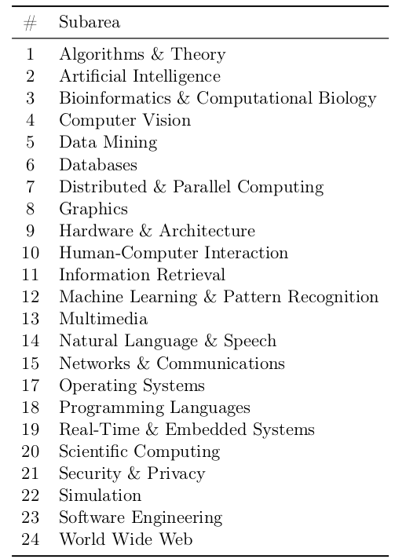
Research Questions
How well Brazilian research groups are doing from the perspective of sub-areas?
How to be fair with sub-areas with a low frequency of publications?

Slide 3
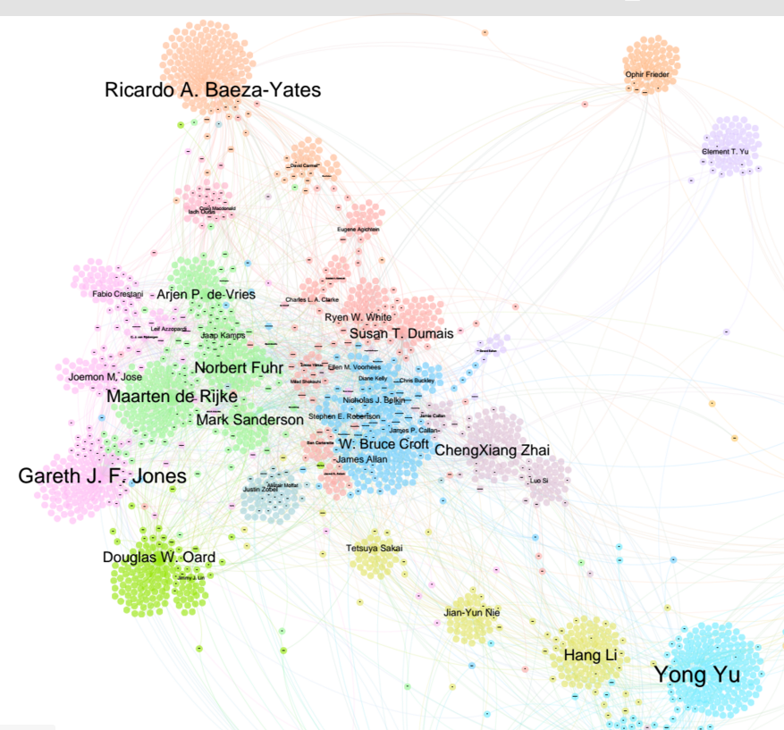
A Clustering Approach

Slide 4
Current Work
Microsoft Academic Graph
Dataset with 120M papers
Coverage analysis (BR, USA and Europe)
Experiments over P-score parameters
Varying how much reputation is propagated between different types of nodes
Goal: find the better configuration of the framework for rank venues by sub-areas

